Slide 1
Chapter 5: Process Description

Slide 2
Process Logic
Data Flow Diagrams good for identifying and describing processes
Not good at showing logic inside processes
Need to specify detailed instructions for elementary processes
How to do it?
Flowcharts & Pseudocode - most end users do not understand them
Natural English - imprecise and subject to interpretation

Slide 3
Problems with Natural English
Many do not write well and do not question writing abilities.
Many too educated to communicate with general audience
Some write everything like it was a program.
Can allow computing jargon, acronyms to dominate language.
Statements frequently have excessive or confusing scope.
Overuse compound sentences.
Too many words have multiple definitions.
Too many statements use imprecise adjectives.
Conditional instructions can be imprecise.
Compound conditions tend to show up in natural English.
Source: Adapted from Matthies, Leslie, The New Playscript Procedure, (Stamford, CT: Office Publications, Inc. 1977)

Slide 4
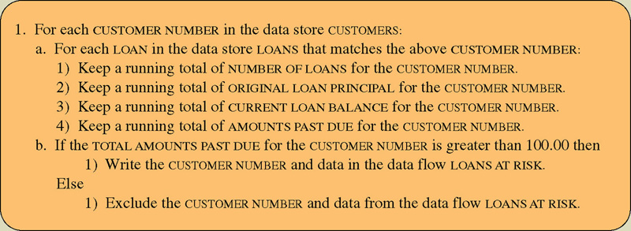
Structured English
Structured English – a language syntax for specifying the logic of a process.
Based on the relative strengths of structured programming and natural English.

Slide 5
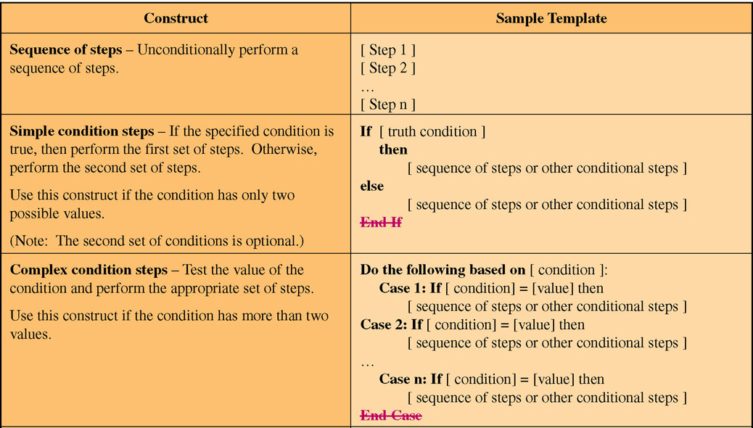
Structured English Constructs (Part 1)

Slide 6
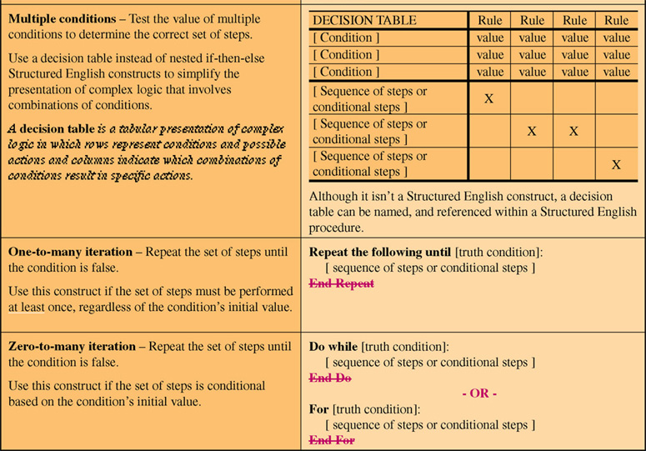
Structured English Constructs (Part 2)

Slide 7
Structured English Restrictions on Process Logic
Only strong, imperative verbs may be used.
Only names that have been defined in project dictionary may be used.
Formulas should be stated clearly using appropriate mathematical notations.
Undefined adjectives and adverbs are not permitted.
Blocking and indentation are used to set off the beginning and ending of constructs.
User readability should always take priority.

Slide 8
Policies and Decision Tables
Policy – a set of rules that govern show a process is to be completed.
Decision table – a tabular form of presentation that specifies a set of conditions and their corresponding actions.
As required to implement a policy.

Slide 9
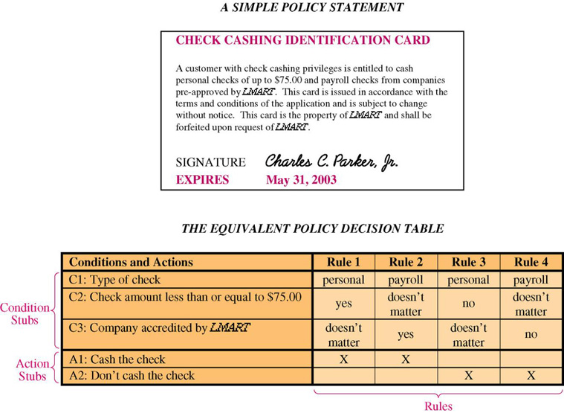
A Simple Decision Table

Slide 10
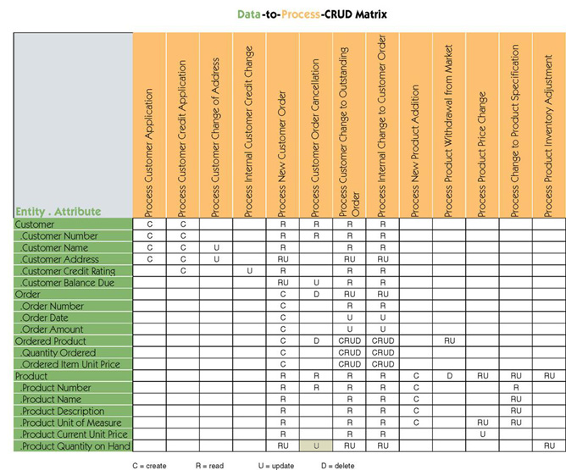
Data & Process Model Synchronization CRUD Matrix

Slide 11
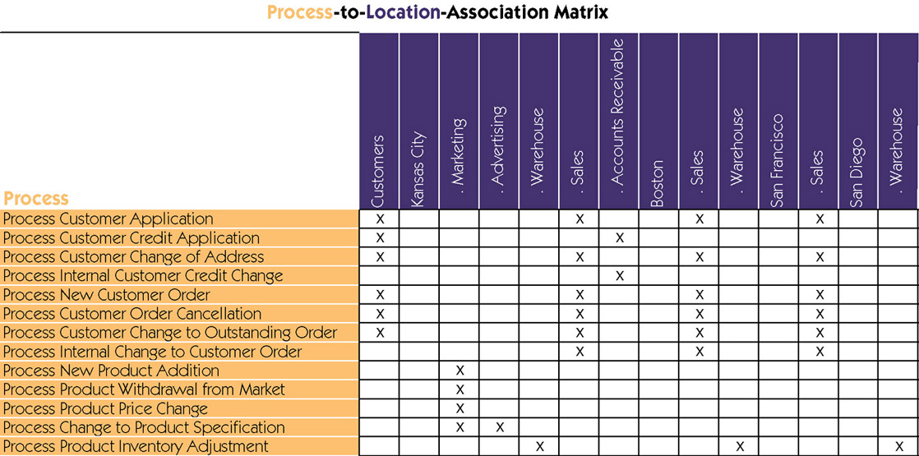
Process Distribution

